Slide 1
BIGDATA 230 final Project
David Brandt
Summer 2019

Slide 2
Summary
This project will analyze the taxi trip pickup and drop-off locations in New York city to see which locations are most and least remote based on the diversity of connecting taxi trips.
I will be patterning my project after the approach outlined by Neo4j Streams Kafka Integration at neo4j.com
BIGDATA 230 FINAL PROJECT – Brandt, Summer 2019

Slide 3
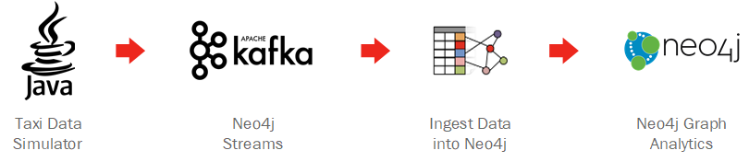
The Pipeline
The pipeline consumes a streaming data source from Kafka using the Neo4j Source plugin in Kafka and the Change Data Source, Sink, and Procedures plugins in Neo4j.
BIGDATA 230 FINAL PROJECT – Brandt, Summer 2019

Slide 4
The Technology Stack
Taxi Data Simulator
Apache Kafka
Kafka Connect: Neo4j Source Plugin (Confluent Hub)
Neo4j Plugin: Change Data Source
Neo4j Plugin: Sink
Neo4j Plugin: Procedures
Docker Compose setups
BIGDATA 230 FINAL PROJECT – Brandt, Summer 2019

Slide 5
The Environment
Based on the challenges I had working with Azure in this and previous quarters I made a choice to forgo the provided Azure VM and build my environment locally.
This choice had major impacts on my project and the challenges I had to overcome, which I didn’t really appreciate at the time.
My project environment is built on a Windows 10 machine using Docker Desktop
I spent a lot of time getting my environment up and running.
BIGDATA 230 FINAL PROJECT – Brandt, Summer 2019

Slide 6
The build: Environment 01
In my first attempt I assembled my list of dependencies then visited each’s site to download and install.
Install Java Version 8
Install Python Version 3.7.4
Install Docker Desktop for Windows
Install Zeppelin Version 0.8.1
Install Kafka Version 2.2.0
Install Neo4j Version 3.4.10
Each is working independently per their site’s quick-start guides. Those with more experience can probably see what is coming next.
BIGDATA 230 FINAL PROJECT – Brandt, Summer 2019

Slide 7
Hurdle 01
My platforms are not working and playing well together! A significant amount of time is lost overcoming this hurdle.
There are conflicts, and errors just trying to get the separate containers all running at the same time.
My machine is lagging and locking up.
Connections are not resolving or timing out.
I review my approach and reevaluate.
BIGDATA 230 FINAL PROJECT – Brandt, Summer 2019

Slide 8
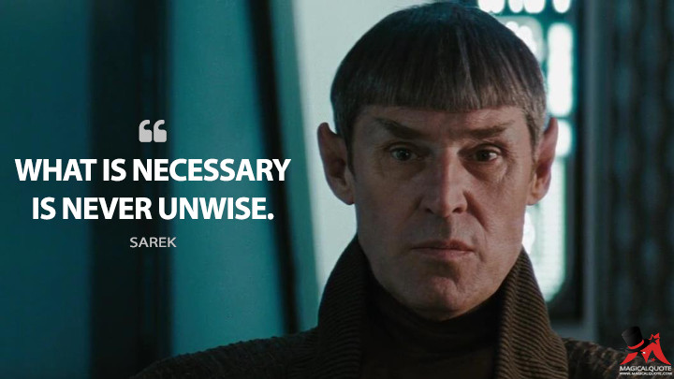
The build: Environment 02
While seeking a solution for my problem I discover Andrea Santurbano (please see Acknowledgements) has posted a docker-compose YML for leveraging Neo4j streams from Kafka on GitHub.
Download from leveraging-neo4j-streams
docker-compose up… and I have an environment!
CONTAINER ID IMAGE
d46f41752c83 confluentinc/cp-enterprise-control-center
dc280b00dad6 confluentinc/cp-kafka-connect
ec59233afa05 neo4j:3.4.10
812748f0a0b4 confluentinc/cp-schema-registry
b98b662cede7 confluentinc/cp-enterprise-kafka
80b5b0bd8a98 confluentinc/cp-zookeeper
33641bc085ae apache/zeppelin:0.8.1
BIGDATA 230 FINAL PROJECT – Brandt, Summer 2019

Slide 9
Hurdle 02
My new Environment 02 is beset by many of the same issues as my original Environment 01.
Booting up takes 40 minutes. Simple operations are taking 20-30 minutes. Connections are timing out, containers are exiting unexpectedly.
Because my build is from a known working configuration I focus now on my hardware.
CPUs: Good
Memory: Good
Disk: Pegged at 100%
My environment is crippled due to poor disk IO.
BIGDATA 230 FINAL PROJECT – Brandt, Summer 2019

Slide 10

The build: Environment 03
When I installed Docker Desktop I chose my D-drive based on available space. D-drive had almost a terabyte available, C-drive was almost full.
I chose poorly. My D-drive is HDD, and my C-drive is SSD.
So, I purged my C-drive to make room. Burned everything down. And reinstalled on the SSD.
This resolved all my issues with crashing, and operations that were half an hour now only take seconds.
BIGDATA 230 FINAL PROJECT – Brandt, Summer 2019

Slide 11
Data Source
the data source will be the Java Taxi Data Simulator provided in the UW BIGDATA 220 course last quarter.
The data source simulates a real-time stream of taxi data from TLC Trip Record Data to Kafka.
BIGDATA 230 FINAL PROJECT – Brandt, Summer 2019

Slide 12
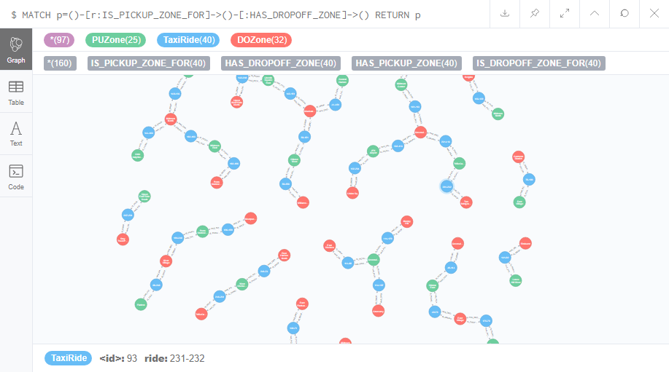
Plan a: Live Environment
BIGDATA 230 FINAL PROJECT – Brandt, Summer 2019

Slide 13
Plan b: Screen Shots
The slides with this black background are provided incase the live environment is not available.
BIGDATA 230 FINAL PROJECT – Brandt, Summer 2019

Slide 14
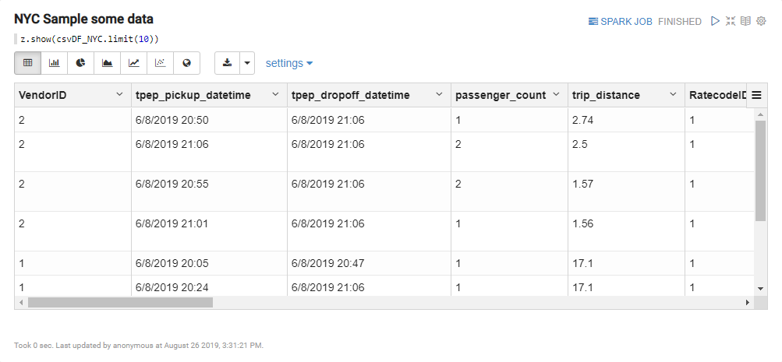
Sample TLC Trip Record Data
BIGDATA 230 FINAL PROJECT – Brandt, Summer 2019

Slide 15
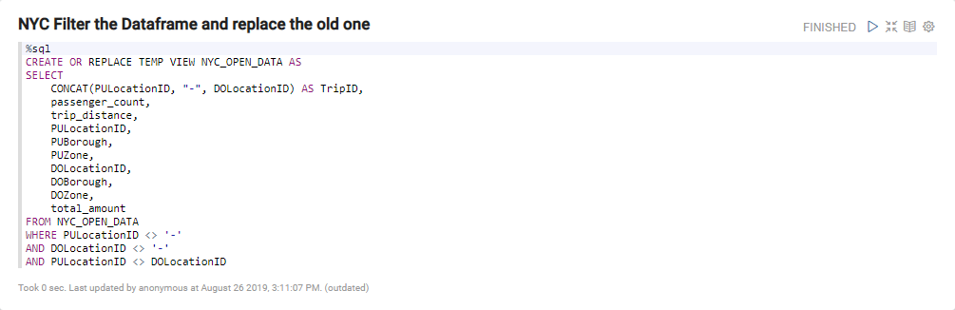
Create the Filter Dataframe
BIGDATA 230 FINAL PROJECT – Brandt, Summer 2019

Slide 16
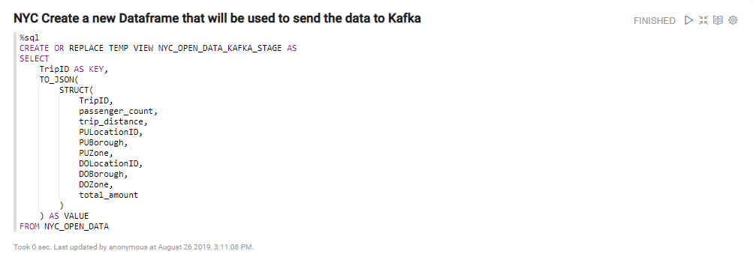
Create the JSON Dataframe that will send data to kafka
BIGDATA 230 FINAL PROJECT – Brandt, Summer 2019

Slide 17
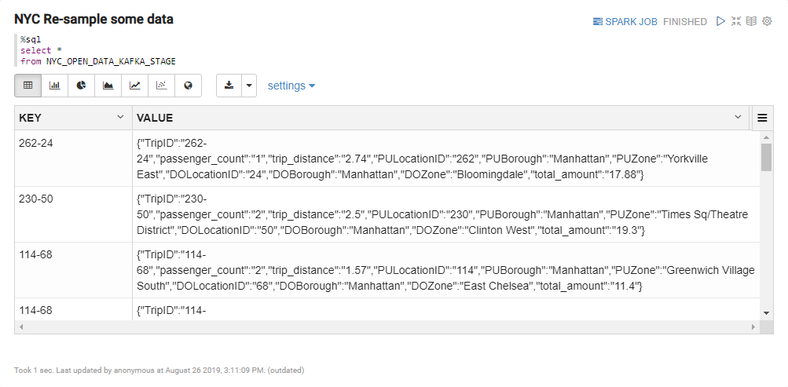
Sample the JSON Dataframe
BIGDATA 230 FINAL PROJECT – Brandt, Summer 2019

Slide 18
Sample the JSON Dataframe
BIGDATA 230 FINAL PROJECT – Brandt, Summer 2019

Slide 19
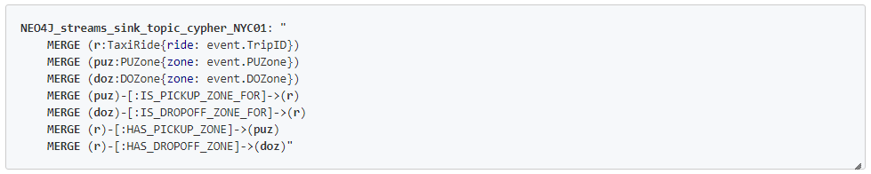
Neo4j Streams Sink Cypher Configuration
This Cypher query is placed at SERVICES → NEO4J → ENVIRONMENT in the docker-compose.yml.
The query tells Neo4j how to consume the stream from the NYC01 topic in Kafka.
BIGDATA 230 FINAL PROJECT – Brandt, Summer 2019

Slide 20
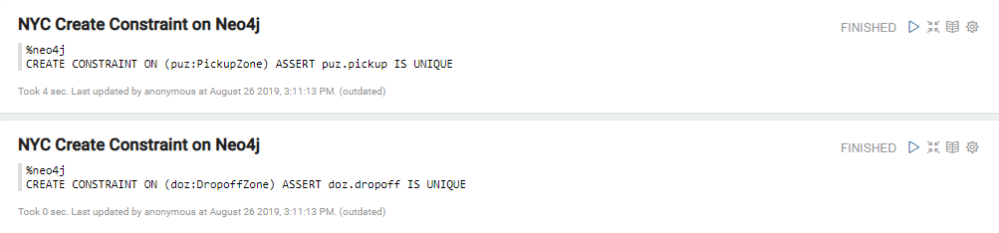
Create Neo4j Constraints
These constraints specify that Pickup and Dropoff locations are unique.
BIGDATA 230 FINAL PROJECT – Brandt, Summer 2019

Slide 21
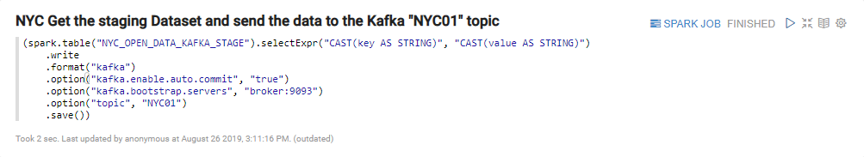
Send our data to kafka
BIGDATA 230 FINAL PROJECT – Brandt, Summer 2019

Slide 22
Send our data to kafka
BIGDATA 230 FINAL PROJECT – Brandt, Summer 2019

Slide 23
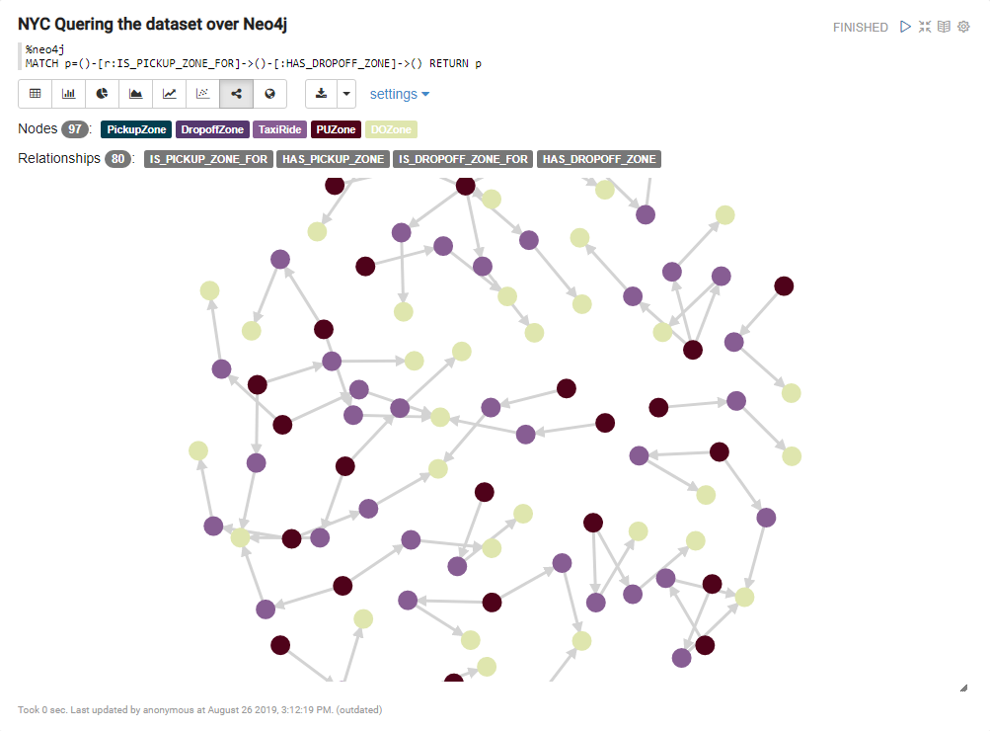
Query dataset from zeppelin
BIGDATA 230 FINAL PROJECT – Brandt, Summer 2019

Slide 24
Query dataset from neo4j
BIGDATA 230 FINAL PROJECT – Brandt, Summer 2019

Slide 25
With more time
I am using a CSV file as the source for my Kafka stream. I would like to have the Taxi Data Simulator wired in as was the original plan.
The translation of the taxi data to the format needed by Neo4j should have been handled by consuming the raw data from Kafka, and then republishing it to Kafka in a separate Topic.
I have graphed the pick-up and drop-off locations of the taxi trips. The analysis is illustrative, but trivial. Some insights would have been nice.
BIGDATA 230 FINAL PROJECT – Brandt, Summer 2019

Slide 26
Lessons Learned
I keep a running log of actions and thoughts while I code. It helps to find my way home if I end up in a blind alley. Here are a select few of my notes from this project.
IO matters.
If at first you don't succeed, restart. Perhaps restart anyway.
That thing your working on, someone has probably already built and tested that.
Docker for Windows works better under Admin privileges.
Remember to install Java. Then, remember to install the right version of Java.
Check docker ps -a to see if everything is still running if you are having issues.
Is this thing locked up? Check your resource monitor.
Don't get pissed. Clean something, then try again.
Docker is awesome!
BIGDATA 230 FINAL PROJECT – Brandt, Summer 2019

Slide 27
Acknowledgements
My original project approach is based on Andrea Santurbano’s in his “Leveraging Neo4j Streams” series on Medium:
How to leverage Neo4j Streams and build a just-in-time data warehouse with Apache Kafka
How to ingest data into Neo4j from a Kafka stream
How to produce and consume Kafka data streams directly via Cypher with Streams Procedures
My environment build is based on Andrea’s leveraging-neo4j-streams docker-compose.yml available on GitHub.
BIGDATA 230 FINAL PROJECT – Brandt, Summer 2019

Slide 28
Thank you!
BIGDATA 230 FINAL PROJECT – Brandt, Summer 2019

